Slide 1
Forecasting Consumer Price Index Data
University of Chicago MS in Applied Data Science
ADSP 31006 Time Series Analysis and Forecasting – Professor Shaddy Abado, Ph.D. Presented 8/18/2025
Team 3
Kate Higgins Gavin Kunish David Li Steve Veldman
Project Code Repository

Slide 2
Motivation
Inflation is a significant economic force that impact both business outcomes and the lives of individuals
While this is a notoriously difficult problem to forecast, it presented a valuable opportunity to apply our skills from this course
We were able to derive interesting and meaningful insights regarding:
The transformations required to make CPI data stationary
The impact of COVID-19 when modeled as an intervention
The relationship between CPI and the Federal Funds Rate.
The impact of other economic variables, such as the Unemployment Rate, Producer Price Index, and Housing Index

Slide 3
Assumptions
Focus on CPI:
There are known endogenous relationships between all of the variables in our dataset
Our primary focus was to forecast CPI, and extract insights around how it is impacted by the other variables in our dataset
Interactions between predictor variables identified as topics for future work
“Beginner's Mind” Approach:
Intentional focus on applying the methods studied in this course
Avoided direct research of professional economists regarding variable relationships during model development
Selected Time Period:
Volatility and uncertainty of current economic environment (particularly tariffs) raise the possibility that we are experiencing the beginning of an additional intervention period
We elected to cut our dataset off at December 2024 to focus on isolating and analyzing the intervention period around the COVID-19 pandemic.

Slide 4
Dataset and Data Engineering
Our primary dataset was the monthly Consumer Price Index, as reported by the US Bureau of Labor Statistics
We selected the time period from January 1990 to December 2024 for our dataset.
Training Dataset: January 1990 - December 2023
Validation Dataset: January 2024 - December 2024
As part of our multivariate analysis we also considered the following variables over the same time periods.
Federal Reserve Funds Rate
Unemployment Rate
Producer Price Index
Housing Index
All variables were retrieved from their corresponding government websites and combined into a single CSV in R.

Slide 5
Variable Definitions
Consumer Price Index: Key economic indicator used to gauge inflation and to adjust various payments and benefits for inflation, such as Social Security payments, wages, and tax brackets. It tracks the prices of a wide variety of goods and services, including food, clothing, housing, transportation, medical care, and recreation.
Federal Reserve Funds Rate: The interest rate at which depository institutions (banks) lend and borrow funds from each other overnight, primarily to meet reserve requirements or for short-term liquidity needs. It is a crucial interest rate in the US economy, set by the Federal Reserve and influencing a wide range of financial activity.
Unemployment Rate: The percentage of the labor force that is unemployed and actively seeking work.
Producer Price Index: Tracks inflation from the perspective of producers, measuring changes in the prices they receive for their goods and services.
Housing Index: The S&P Cotality (formerly known as Case-Shiller) Case-Shiller Home Price Indices are the leading measures of U.S. residential real estate prices, tracking changes in the value of residential real estate nationally.

Slide 6
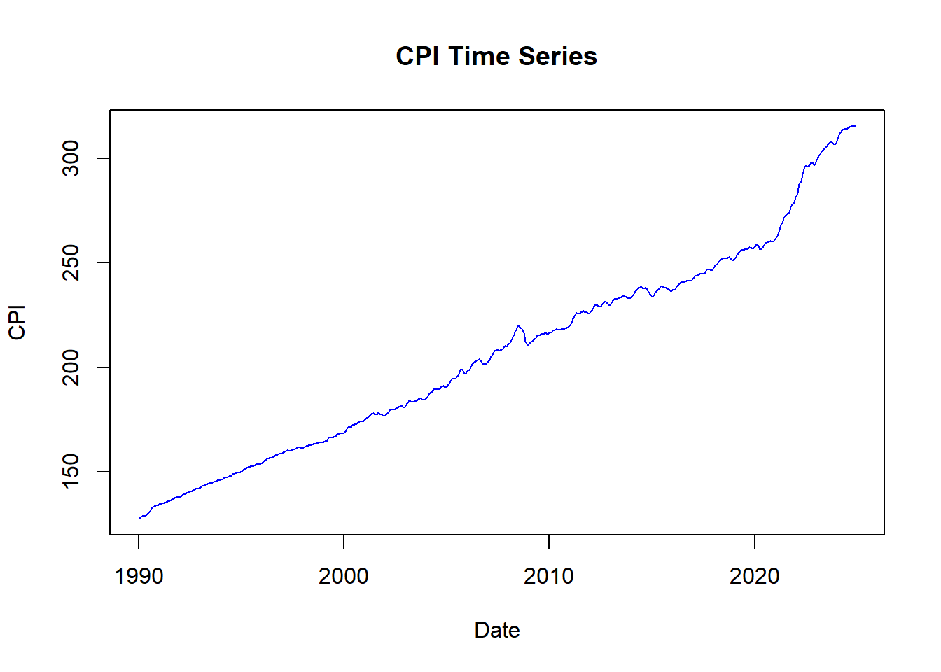
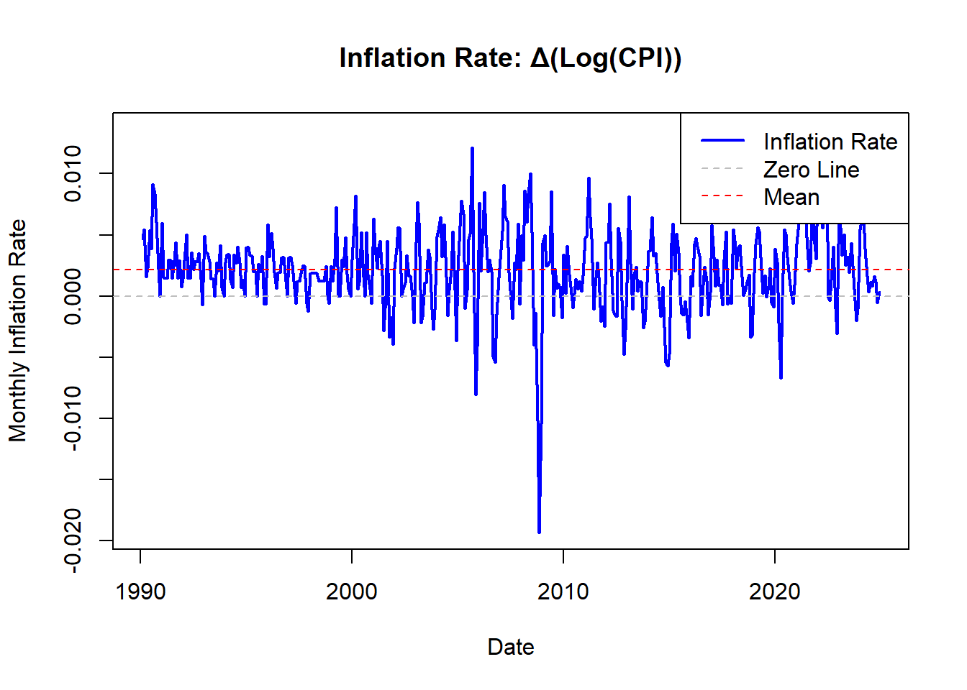
Variable Transformations and EDA
CPI required log transformation and 1st order differencing to achieve stationarity

Slide 7
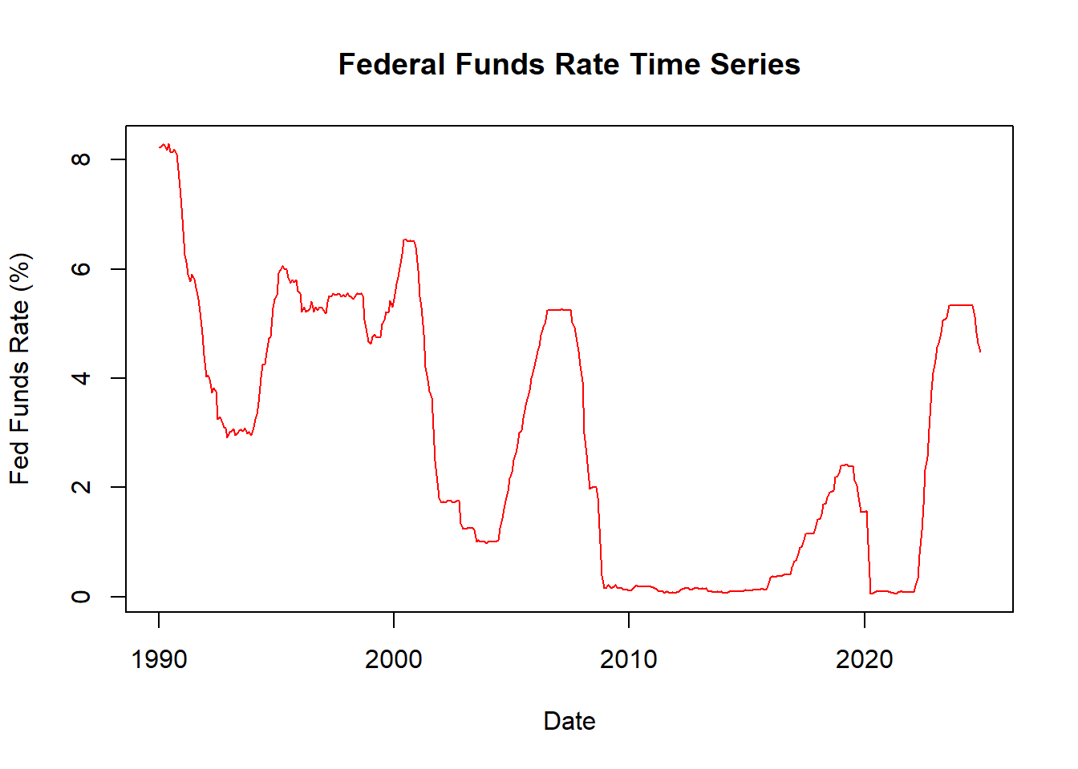
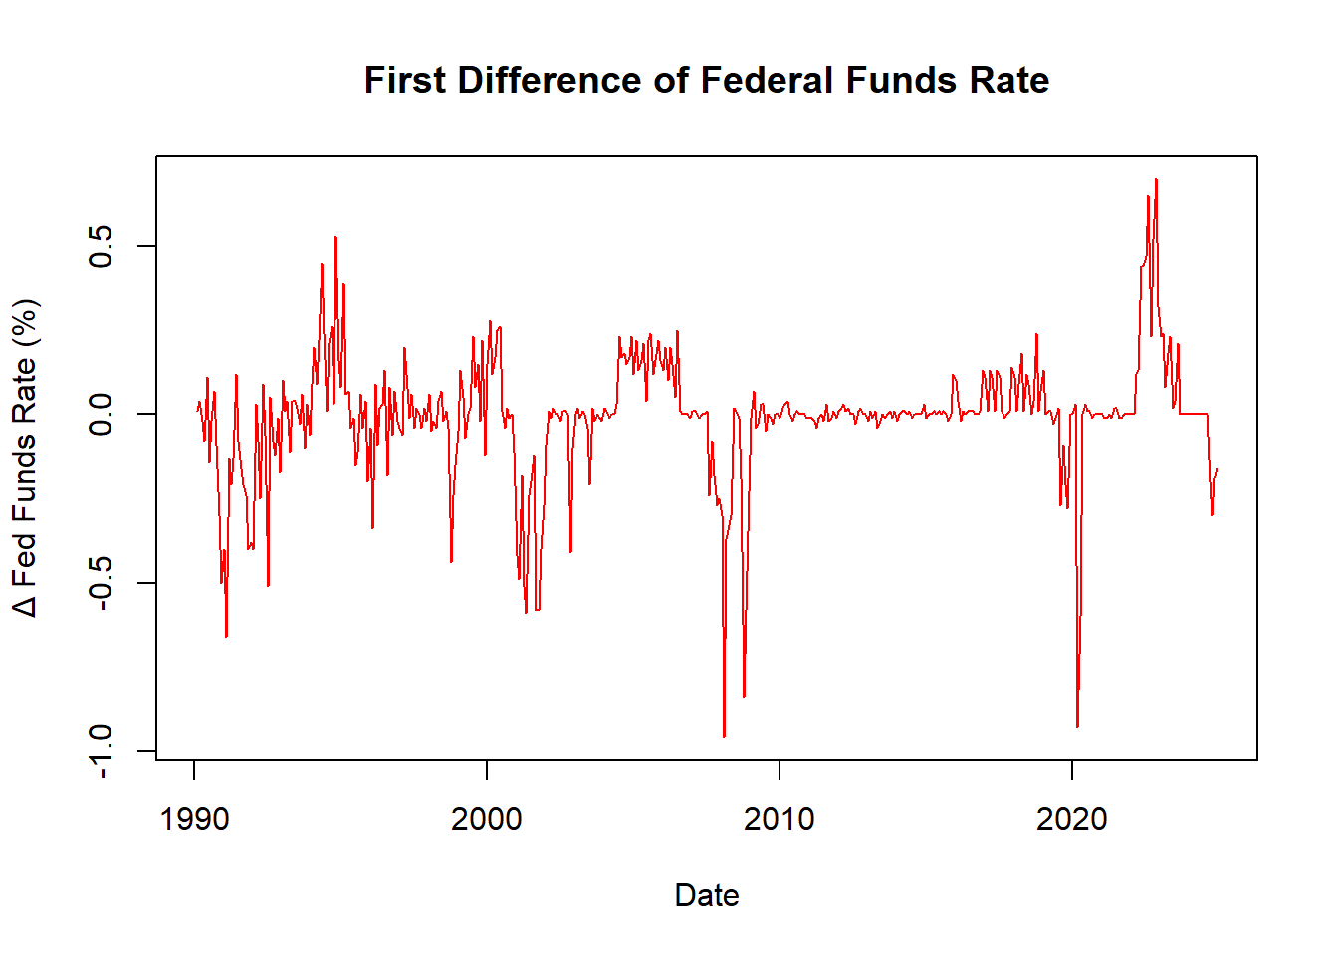
Variable Transformations and EDA
Fed Funds was made stationary with 1st order differencing

Slide 8
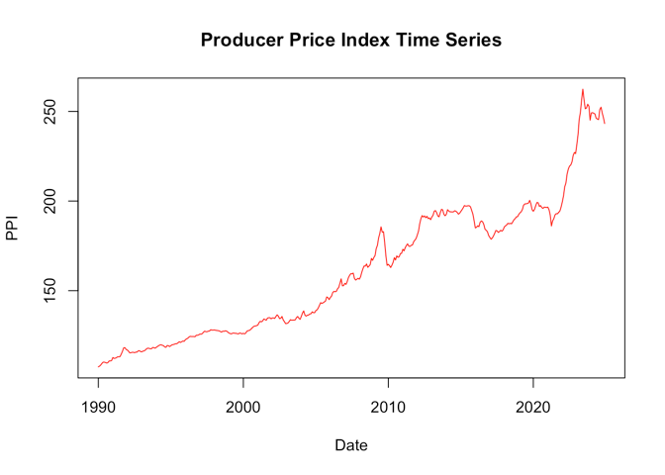
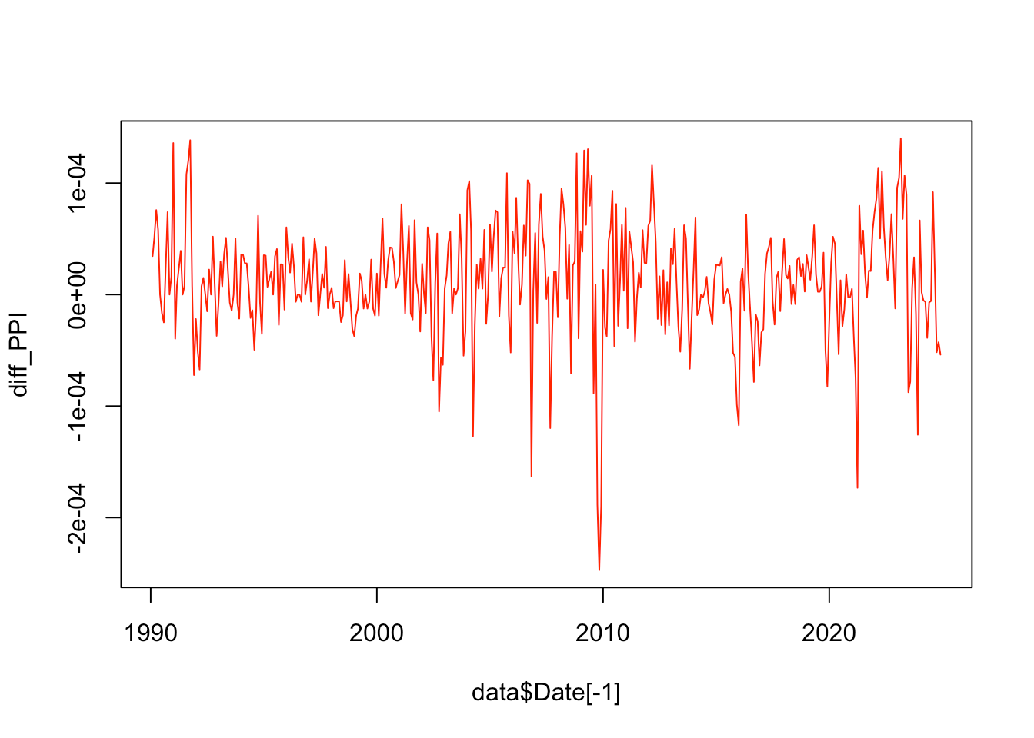
Variable Transformations and EDA
PPI achieved stationary with box-cox transformation and 1st order differencing

Slide 9
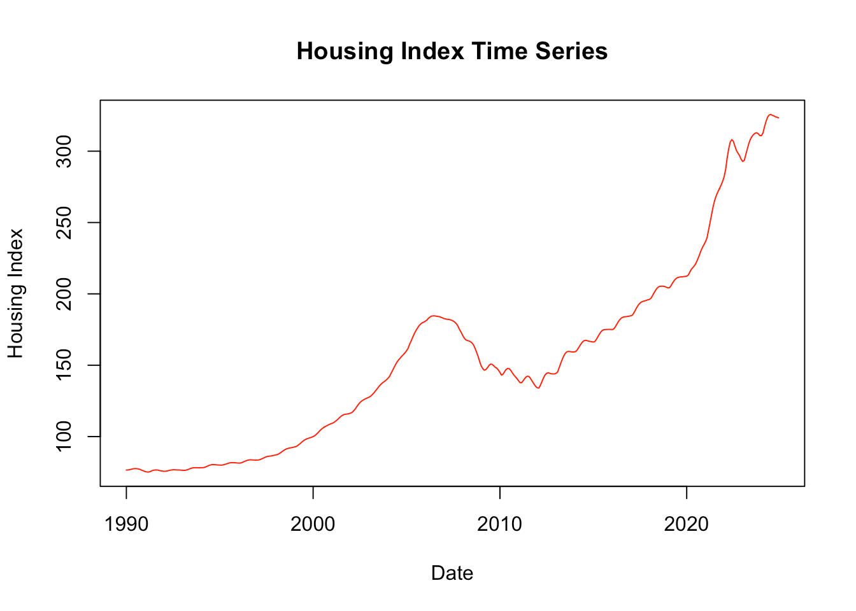
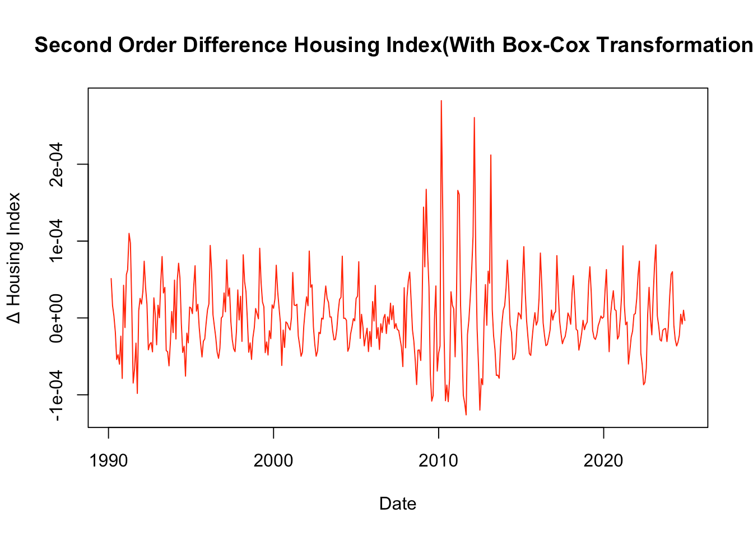
Variable Transformations and EDA
Housing Index achieved stationary with box-cox transformation and 2nd order differencing

Slide 10
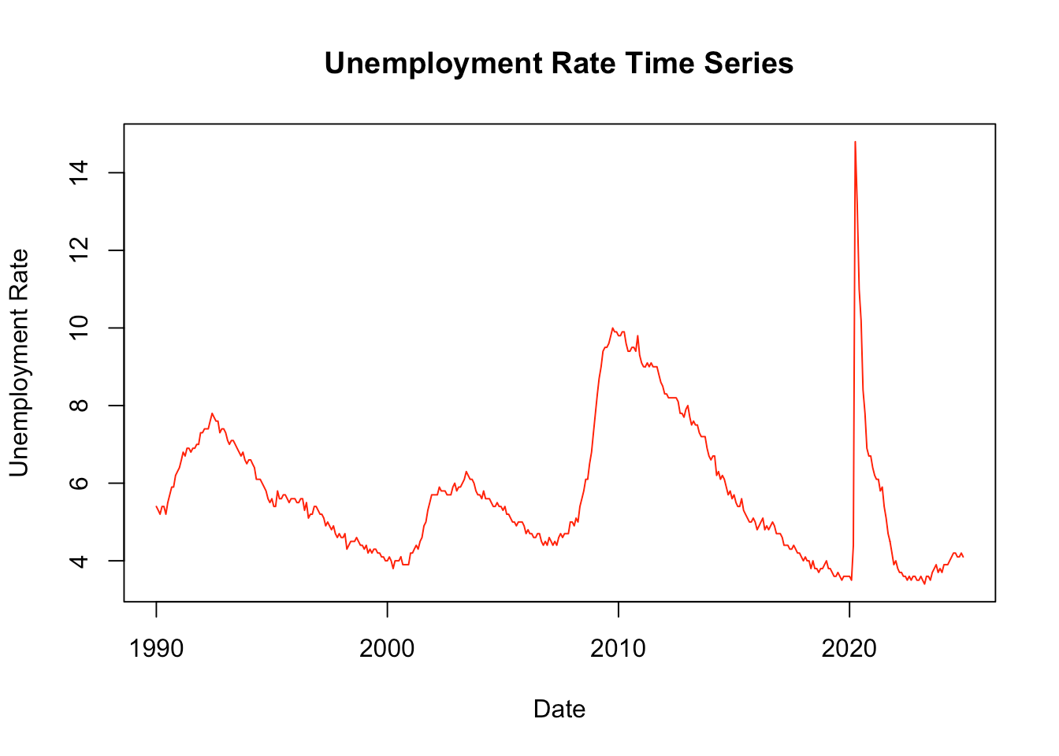
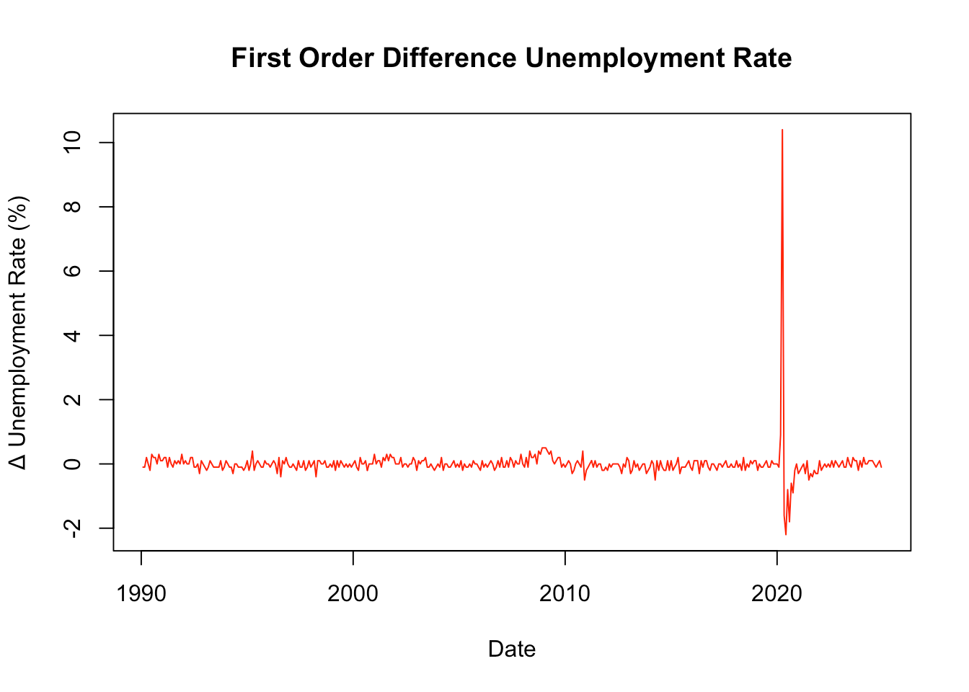
Variable Transformations and EDA
Unemployment achieved stationarity with first order differencing

Slide 11
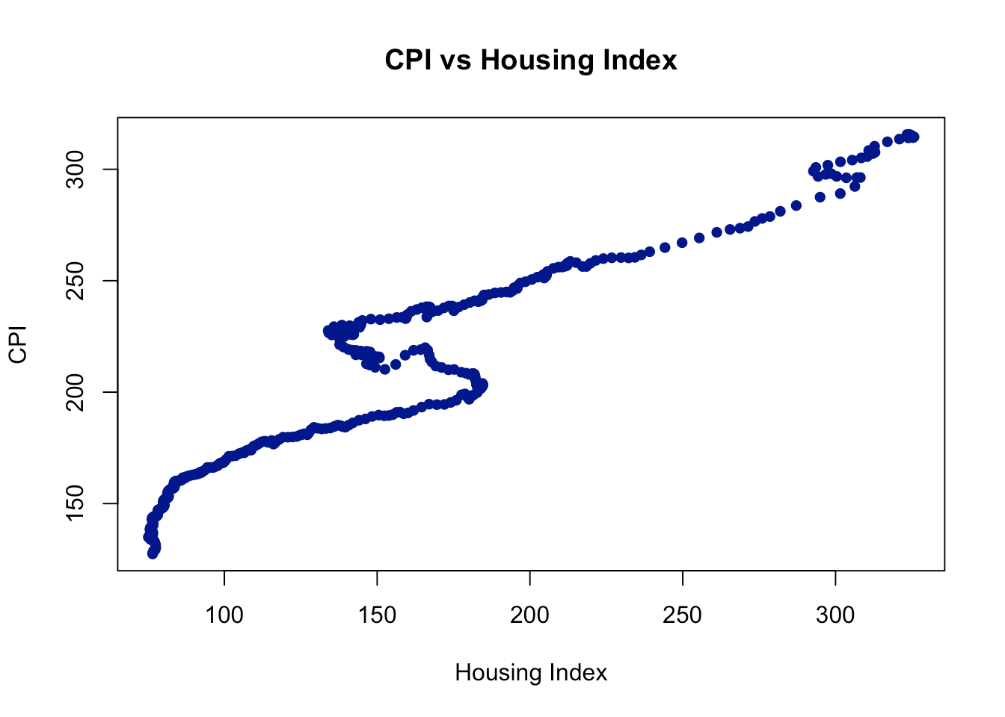
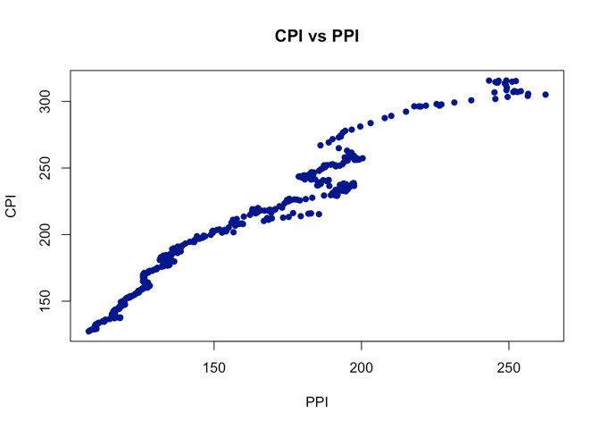
Variable Transformations and EDA
Variables show clear relationships, but do not always follow a linear pattern
Correlation: 0.951
Correlation: 0.977

Slide 12
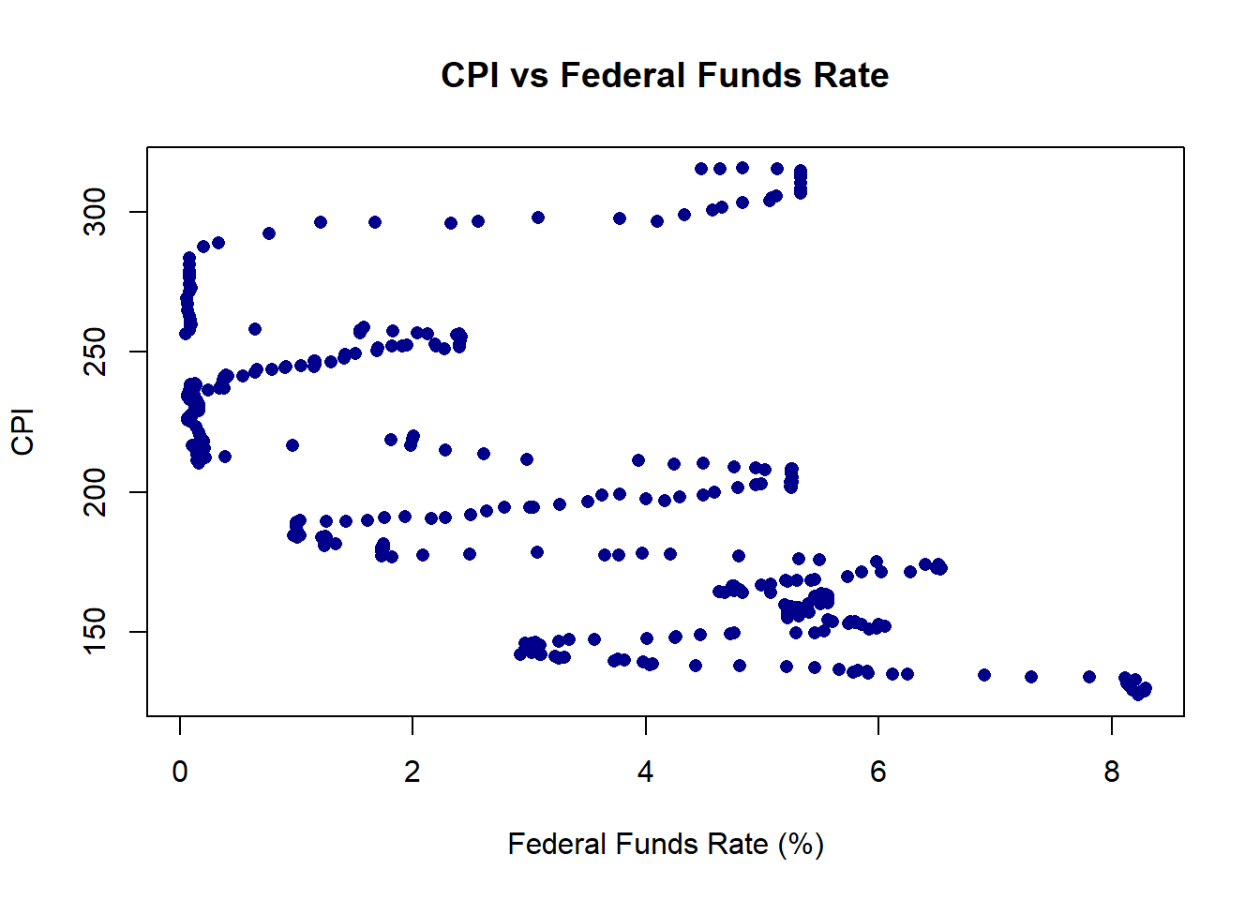
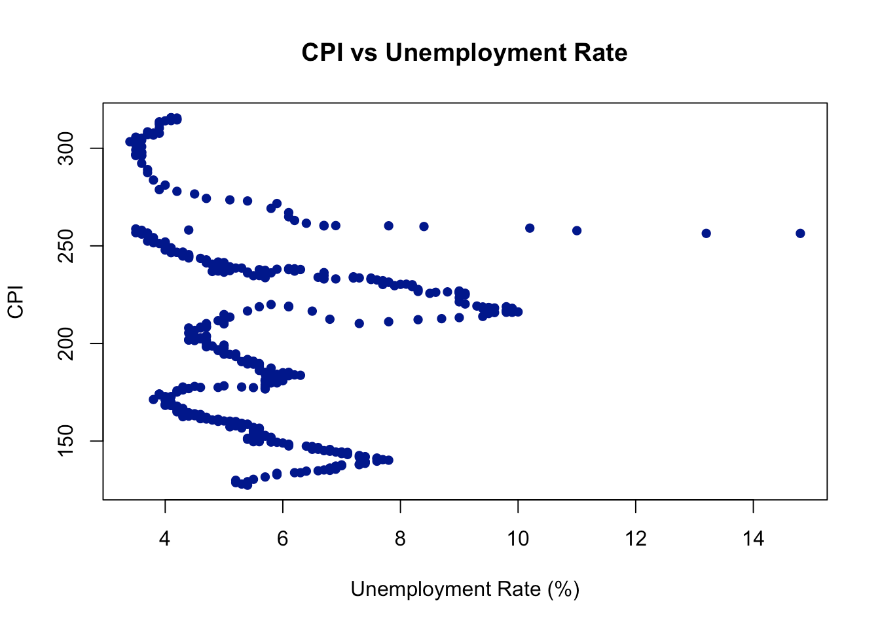
Variable Transformations and EDA
Variables showed clear relationships, but do not always follow a linear pattern
Correlation: -0.4902
Correlation: -0.1745

Slide 13
Models Considered
Univariate ARIMA:
Baseline model to benchmark evaluation metrics
Informs further advanced modeling approaches and decisions
Dynamic Harmonic Regression:
Alternative approach to capture complex seasonality
Validate best intervention function specification
Vector Autoregression (VAR):
Captures cross-correlation between variables
Particularly relevant given known endogenous relationships in economic data
Beginning with the ARIMA baseline, we utilized a champion-challenger approach to evaluate progressively more complex models, arriving at a VAR model utilizing CPI, Fed Funds, PPI, and Housing Index as our final Champion model.

Slide 14
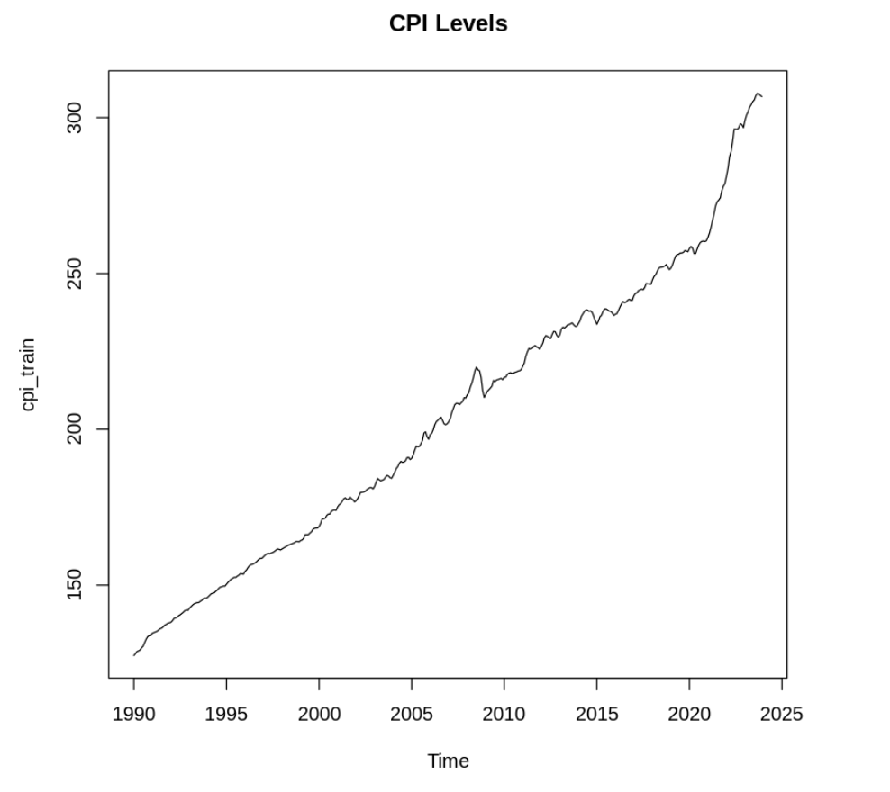
Models – Univariate ARIMA
Baseline Approach
Established univariate forecasting benchmark before adding economic variables
Two strategies tested: CPI levels vs. inflation rates
CPI levels: ARIMA(0,2,3)[12] - required 2nd differencing (non-static)
Inflation Rates: ARIMA(2,0,2)(2,0,0)[12] - naturally stationary
Key Result
Inflation rate approach superior (RMSE: 1.57 vs. 1.71)
Direct inflation modeling more effective than CPI transformation

Slide 15
Models – Univariate ARIMA
Model Specifications
CPI Levels: ARIMA(0,2,3)(0,0,2)[12] - required for second stationary
Inflation rates: ARIMA(2,0,2)(2,0,0)[12] - naturally stationary with autoregression structures
Diagnostic Assessment
Both models failed Ljung-Box tests (p < 0.05) indicating residual autocorrelation
Suggests univariate models miss important structural relationships in CPI data
Standard model assumptions violated despite reasonable forecasting performance
Economic Interpretation
AR(20) structure in inflation model captures persistence in inflationary shocks
Seasonal MA terms reflect recurring annual price adjustments patterns
Missing external drivers (monetary policy, labor markets) likely source of residual correlation

Slide 16
Models – Univariate ARIMA
Implications for Team Analysis
Diagnostic failures justify team’s multivariate modeling approaches
Establishes RMSE benchmark for model comparison
Demonstrates need for external economic variables in CPI forecasting
Key Limitation
Univariate approach insufficient for capturing economic relationships driving inflation

Slide 17
Models – Dynamic Harmonic Regression
Dynamic Harmonic Regression with ARIMA errors
Model goals:
Capture seasonality
Capture pandemic intervention period
Stretch goal: Capture exogenous variables (FedFunds etc.)
Model specification steps:
Regression component specification
Intervention function
Harmonic function
Regression + ARIMA errors specification
Incremental model building with AICc lift
Validation on test set

Slide 18
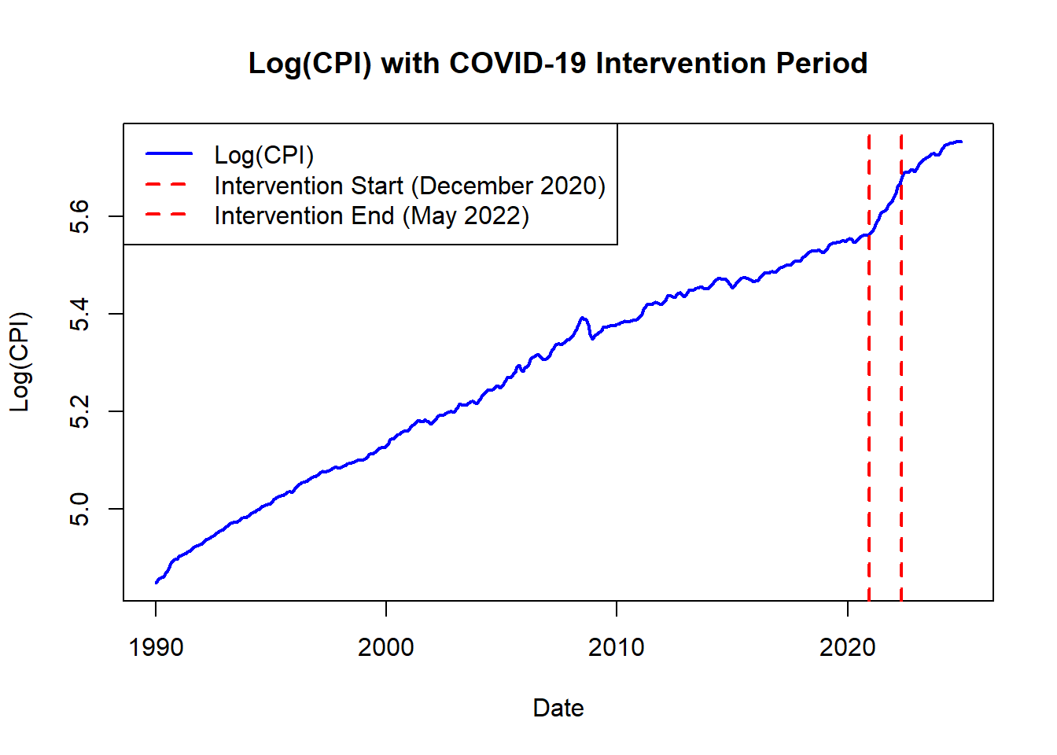
Models – Dynamic Harmonic Regression
Regression component specification → Intervention function
Visual Inspection
Clear level and trend change between December 2020 and May 2022
Returns close to pre-pandemic levels after May 2022
Hypothesis Test
Validated as part of VAR model
Results suggest the intervention function should be specified either as a step or ramp function

Slide 19
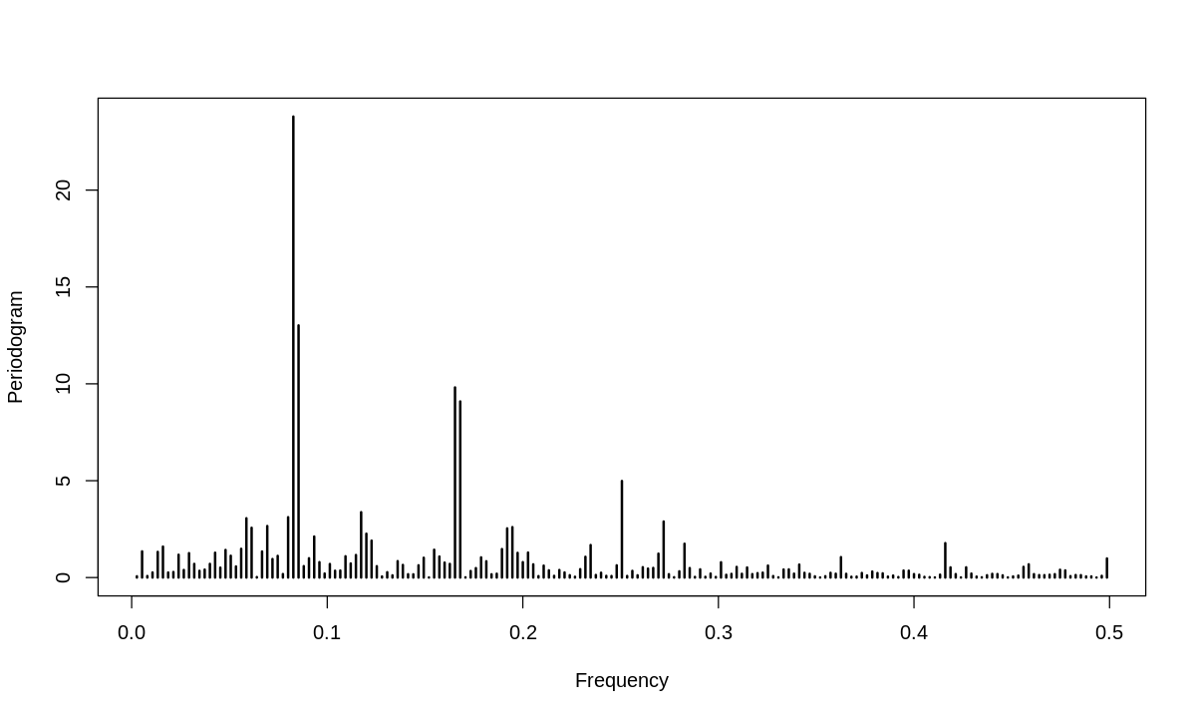
Models – Dynamic Harmonic Regression
Regression component specification → Harmonic function
Spectral analysis prerequisite
Non-seasonal d=1
ADF/KPSS tested stationary
Periodogram
Dominated by four frequencies
Inverse indicates periods at 12 and 6
1/f = 12
1/f = 6
Results confirms seasonality with suitable fourier orders (K) between 2 through 4

Slide 20
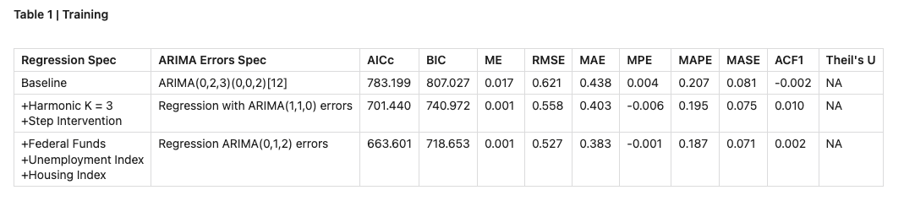
Models – Dynamic Harmonic Regression
Regression + ARIMA Errors specification results
Two step methodology
Incrementally specify regression components individually
Allow auto.arima() to specify error model component
Assess AICc lift
Best model on training
This greedy search yielded a best model including all discussed regression components (excluding PPI)

Slide 21
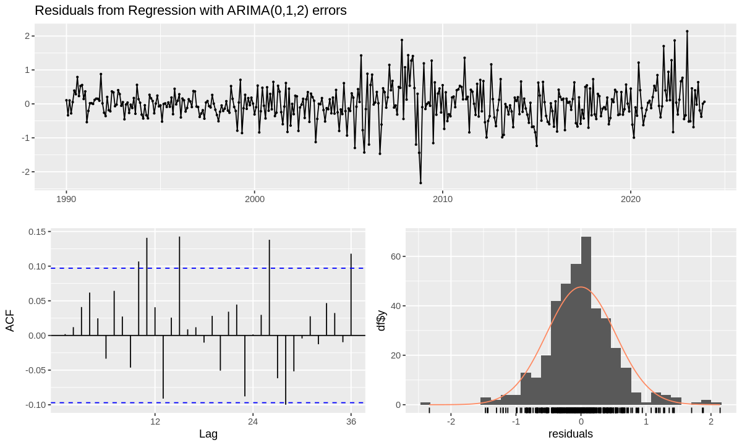
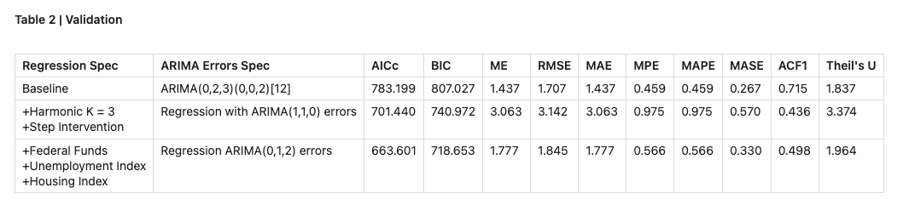
Models – Dynamic Harmonic Regression
Regression + ARIMA Errors validation
Residuals
Ljung-box tested not independent
Significant lags are not at seasonal periods
Test performance
Best model on validation
Dynamic harmonic regression models overfit and do not generalize as well as baseline ARIMA model

Slide 22
Models – VAR
Baseline model with CPI and Fed Funds dataset:
Establishing stationarity for both variables
Log transformation and 1st order differencing for CPI
1st order differencing for Fed Funds
Both variables showed yearly seasonality
Moderate for SPI
Weak for Fed Funds
Incorporated seasonality into the VAR model rather than apply seasonal differencing
VARselect indicated optimal lag order of 2 based on BIC, 3 based on AIC
Both lag orders were used to construct baseline models, step intervention models, and level increase intervention models.
Step intervention model outperformed baseline and level increase intervention models on all metrics for both lag orders
Lag order 3 selected based on adjusted R²

Slide 23
Intervention Analysis: COVID-19
Major Pandemic-Related Inflation Drivers:
Supply chain shortages and consumer hoarding increased scarcity of many consumer goods
Stimulus checks injected ~$814 billion into the US economy between March 2020 and December 2021
Intervention Period:
Structural break clearly visible in December 2020 data (delayed impact)
Stabilization of data generating process visible starting May 2022

Slide 24
Intervention Analysis Validation
 | LR Statistic | p-value
Baseline v Step Intervention | 20.187 | 0
Baseline v Level Shift Intervention | 15.32 | 0.0005
 | Lag 2 |  |  | Lag 3
Model | AIC | BIC | Adj R² | AIC | BIC | Adj R²
Baseline | - 4,117.78 | - 3,989.66 | 0.4849 | - 4,125.37 | - 3,981.32 | 0.4716
Step Intervention | - 4,135.75 | - 3,999.65 | 0.5120 | - 4,141.55 | - 3,989.50 | 0.4955
Level Shift Intervention | - 4,129.41 | - 3,993.27 | 0.5007 | - 4,136.69 | - 3,984.64 | 0.4858

Slide 25
Comparison of VAR Models
Model (CPI +) | Optimal Lag | AIC | BIC | Mult R² | Adj R² (CPI) | RMSE (CPI)
Fed Funds | 3 | - 4,130.77 | - 3,978.81 | 0.5191 | 0.4965 | 1.2193
PPI | 6 | - 10,533.74 | - 10,334.16 | 0.5344 | 0.5046 | 1.5709
Housing | 3 | - 10,888.87 | - 10,736.91 | 0.5122 | 0.4893 | 1.1547
Unemployment | 9 | - 2,920.55 | - 2,673.54 | 0.5223 | 0.4831 | 1.3823
Notes:
To begin the model comparison process, we decided to test all variables in a simple 2 variable model. Based on the correlation between each variable and CPI, we had our assumptions on which variables would perform the best. Little to our surprise, PPI and Housing performed best as both of them had a correlation coefficient over .95, while Unemployment had the lowest correlation coefficient and also performed worst. We can also see that the Fed Fund model also still performed admirably.

Slide 26
Comparison of VAR Models
Model (CPI +) | Optimal Lag | AIC | BIC | Mult R² | Adj R² (CPI) | RMSE (CPI)
PPI + Housing | 6 | - 17,698.95 | - 17,327.74 | 0.5394 | 0.502 | 1.6095
PPI + Fed Funds | 6 | - 10,961.83 | - 10,590.63 | 0.5528 | 0.5165 | 1.1884
PPI + Fed Funds + Housing | 6 | - 18,123.16 | - 17,532.42 | 0.5576 | 0.5138 | 1.2426
PPI + FF + Housing + Unemployment | 7 | - 17,368.29 | - 16,410.94 | 0.5581 | 0.4989 | 1.2243
Notes:
After acquiring all the information from the 2 variable models, we began with more complex modeling. Given that PPI and Housing previously performed the best, with Fed Funds not far behind, we decided to feature these three variables in different model iterations. This is why you will see that outside of the full model, Unemployment isn’t present. From this table we can see that the PPI and Housing model performs well until we calculate the RMSE and see that it is significantly higher than the other models. Conversely, the PPI and Fed Funds Model has the best RMSE of the group, but it’s AIC and BIC values are severely lacking. This leads us to the full model and the PPI/Fed Fund/Housing model. While the full model performs very well, the low adj R^2 from the added complexity of Unemployment doesn’t add enough to the other metrics to make the dip in explanatory power worth it, ultimately leaving us with the PPI/Fed Funds/Housing Model. Although this model doesn’t lead in all categories, it is strong in each, allowing us to crown it as the Champion Model.

Slide 27
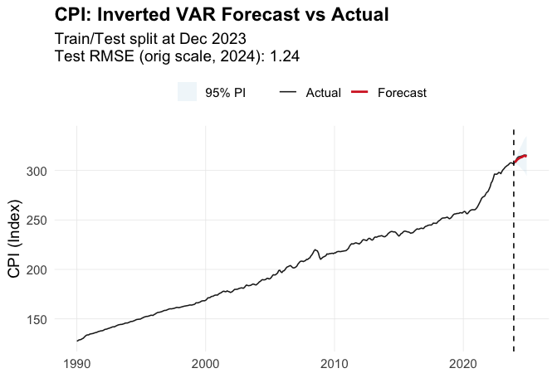
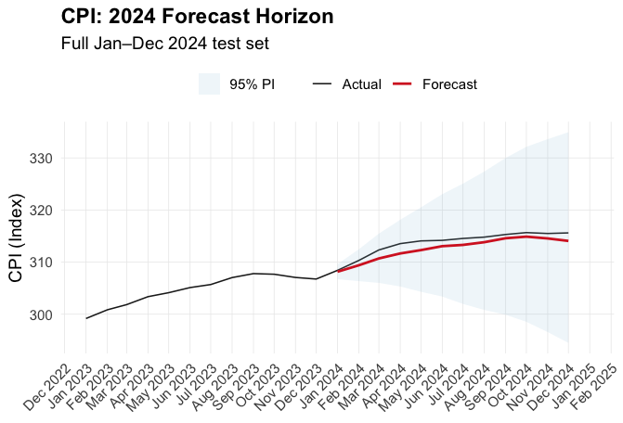
Champion Model
VAR Model with CPI, PPI, Fed Fund, and Housing Index
Notes:
Our forecast of the Champion model has a few very interesting characteristics. First and foremost, as you can see on the zoomed in plot, our forecast very closely matches the actual CPI for the entirety of 2024. Next, while the fanning of the Confidence Interval may look a bit extreme in the zoomed in plot, when we look at it over the entirety of the time series, it isn’t too much different from some of the dips and rises along the plot, leading us to determine that it is a very reasonable confidence interval. Lastly, we wanted to know how our forecast compared to that of an actual economic organization. We found a history of CPI Index projections from the International Monetary Fund, and to our surprise, our projections weren’t too far off. The IMF predicted an EOY CPI of 316.8, and we predicted an EOY CPI of 314.1, while the actual EOY CPI was 315.6.

Slide 28
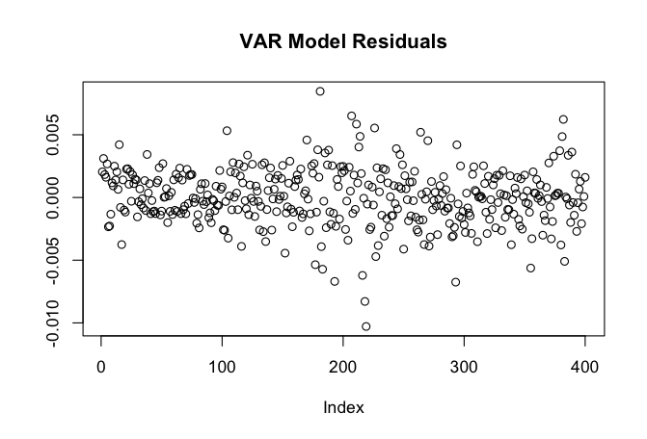
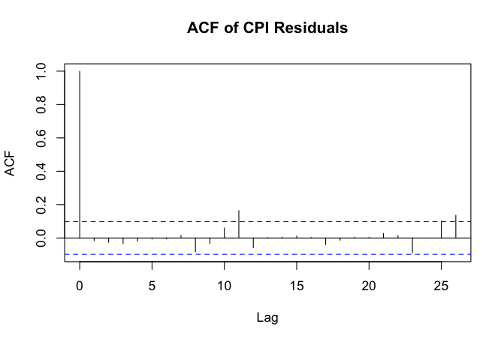
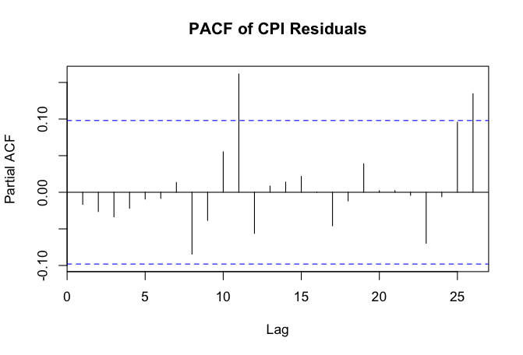
Champion Model Residuals
Notes:
The area with the most improvement to be made is definitely in the residual checks. While there isn’t any noticeable trends in the residual plot, and it hovers mainly around zero, things start to get dicey at the ACF and PACF plots. There is clearly remaining residual autocorrelation as we see several significant lags in both plots. There are certainly still underlying patterns that need to be addressed.

Slide 29
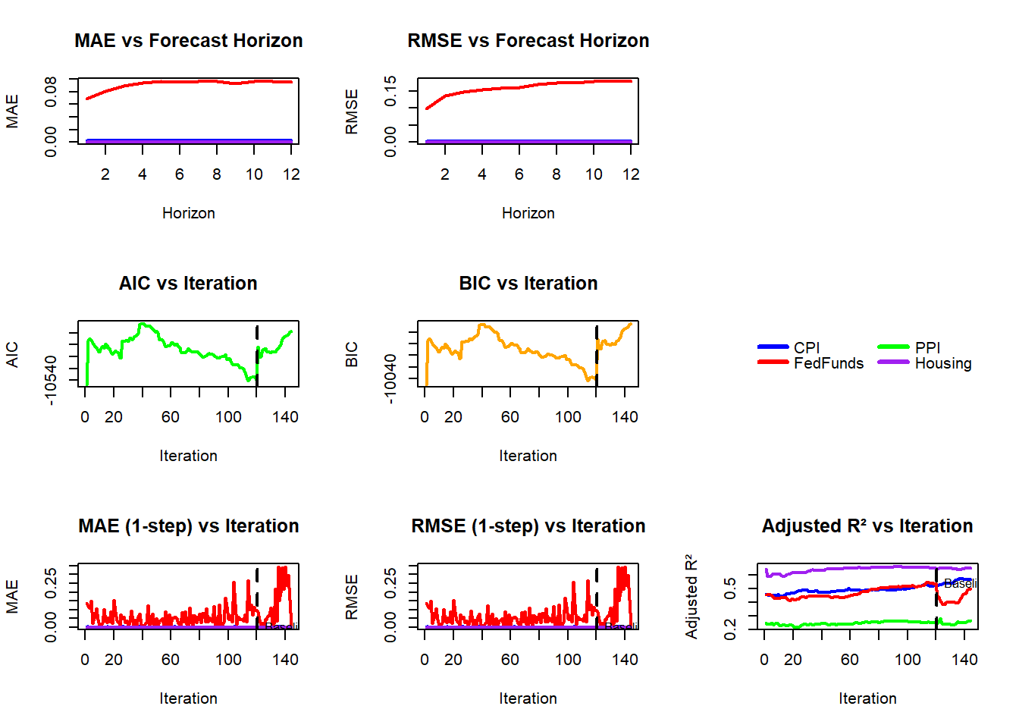
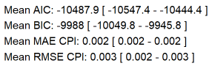
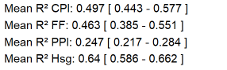
VAR Model Cross Validation
Evaluated Multiple Model Versions
2 and 4 variable models
With and without intervention
Challenges regarding intervention models
Convergence issues
Need for hybrid model
Model stability
Strongly correlated with stability of variables
Improved by intervention analysis
Excellent overall stability for final model

Slide 30
Conclusions
VAR models represented significant improvement over other modeling methodologies
Strong correlation between CPI and PPI, Fed Funds, and Housing Index
Negates need for individual modeling/forecasting for each variable
Unique relationships between CPI and other variables
Lag order of 3 captures most of the impact of Fed Funds and Housing Index
PPI proved most predictive, and required lag order of 6 to fully capture
Intervention models meaningfully captured the structural break caused by COVID-19
As expected, step intervention better modeled this process than level shift intervention
Autocorrelation of residuals in final model indicates additional unaccounted for patterns
There are likely additional variables not included in this analysis that represent a nontrivial component of the data generating process

Slide 31
Recommended Future Work
Incorporate additional predictor variables
Employment Cost index
Consumer Expenditure Survey
Purchasing Power Parity
Additional Intervention Analysis
2008 Recession
Potential current intervention event
Additional Modeling Approaches
Machine Learning Algorithms (Random Forest, XGBoost)
Artificial Intelligence (Deep Neural Networks/LSTMs, Transformer Architectures)
Expand scope to include great focus on forecasting predictor variables

Slide 32
Thank You
Team 3
Kate Higgins Gavin Kunish David Li Steve Veldman
Project Code Repository

Slide 33
Team Contributions
Kate Higgins
Baseline ARIMA Modeling
Foundational Insights to Inform Advanced Modeling
Gavin Kunish
Data Engineering (extracted data from BLS websites and integrated into single dataset)
VAR Modeling with Additional Variables (PPI, Unemployment, Housing Index)
David Li
Harmonic Regression Modeling
Intervention Analysis
Steve Veldman
Baseline VAR Modeling (CPI & Fed Funds)
Intervention Analysis
Cross Validation
*All team members contributed equally to data selection, project ideation and planning, presentation preparation, code reviews, and peer review/critique of the above models.

Slide 34
Appendix

Slide 35
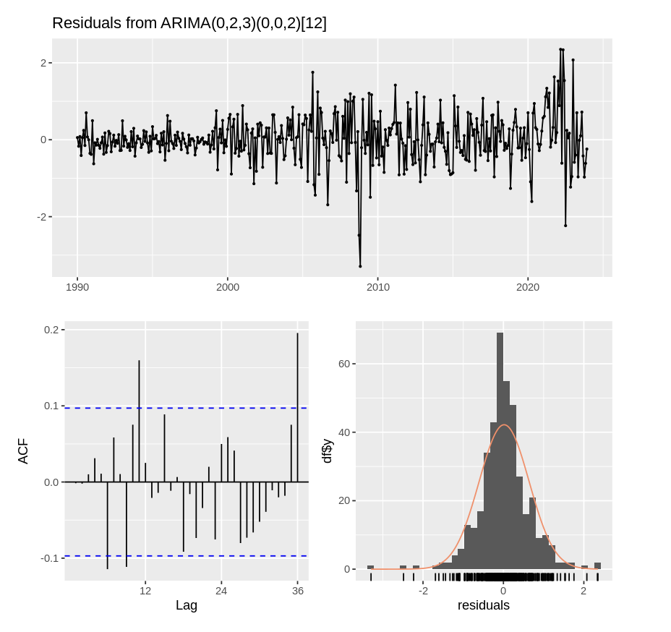
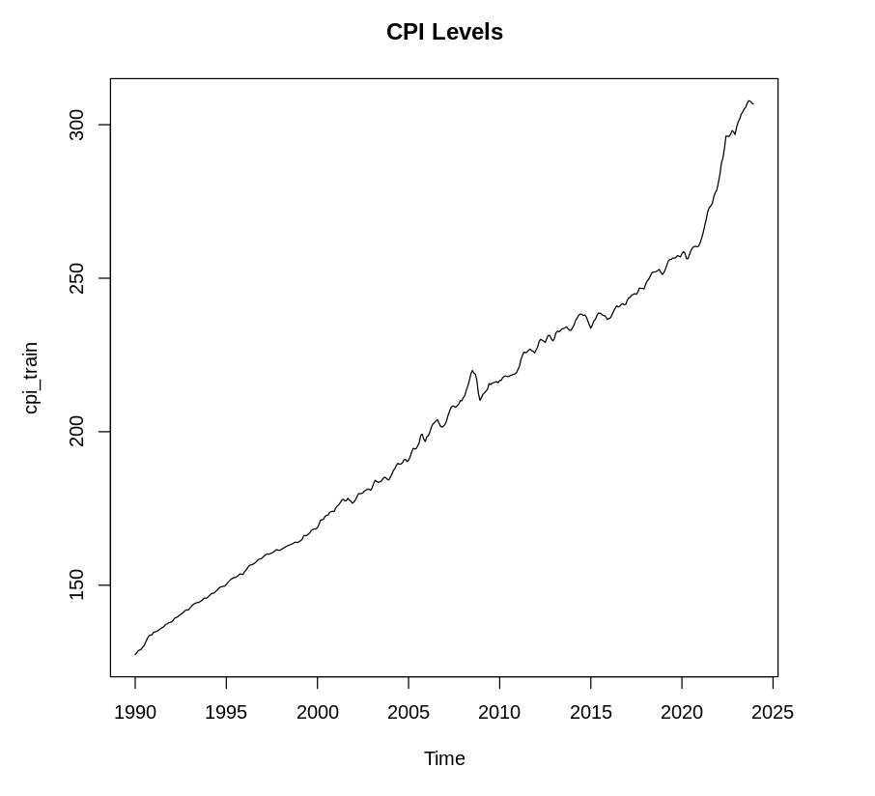
Baseline ARIMA

Slide 36
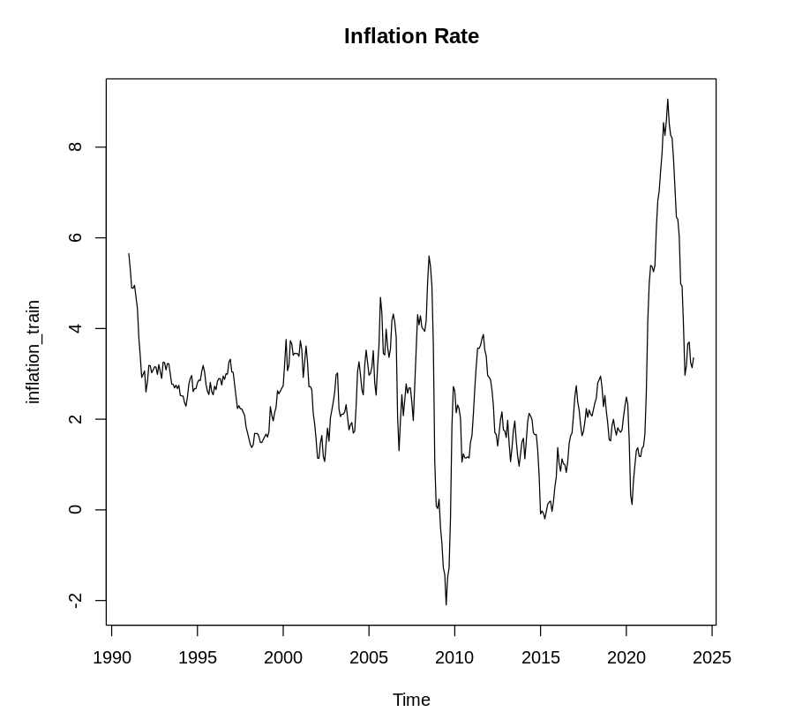
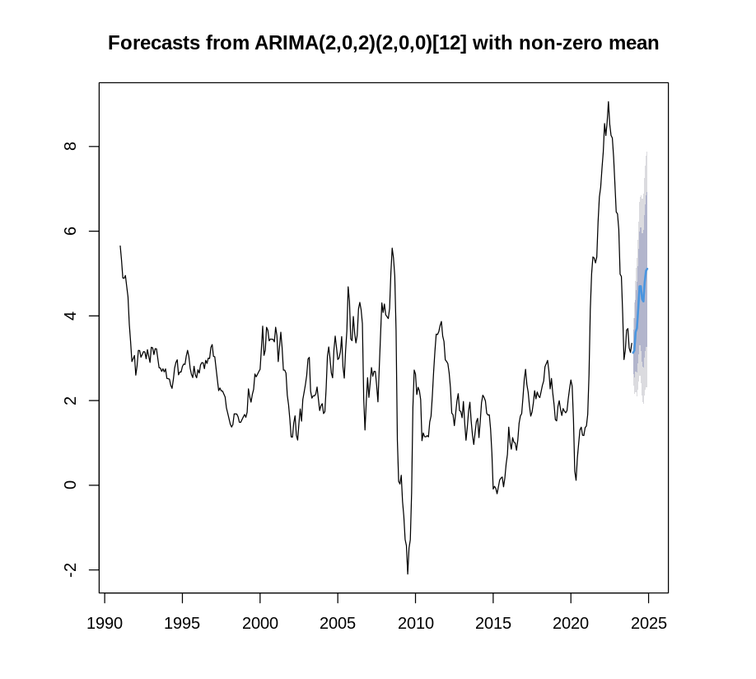
Baseline ARIMA

Slide 37
Baseline ARIMA - Key Results
Approach | Model Specification | ADF Test p-value | Stationarity | Test RMSE
CPI Levels | ARIMA(0,2,3)(0,0,2)[12] | 0.99 | Non-stationary | 1.71
Inflation Rate | ARIMA(2,0,2)(2,0,0)[12] | 0.01 | Stationary | 1.57
Winner: Inflation Rate ARIMA (lower RMSE)
Performance Improvement: 8.3% better forecasting accuracy
Stationarity: Direct inflation modeling avoided differencing complication
Both models failed residual diagnostic tests, indicating need for external variables

Slide 38
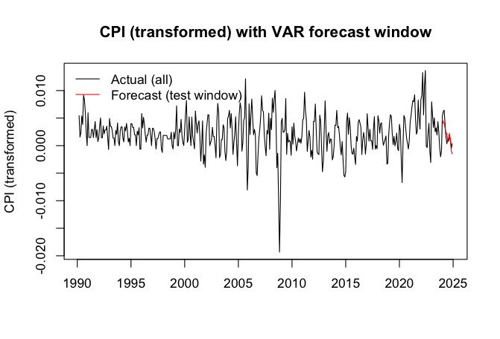
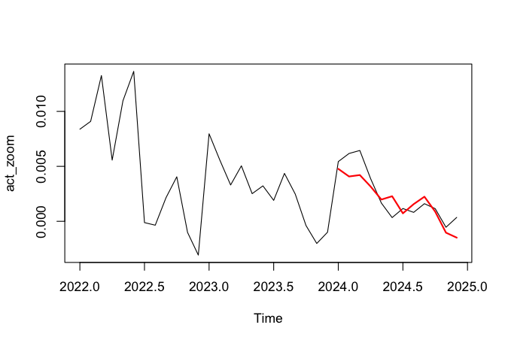
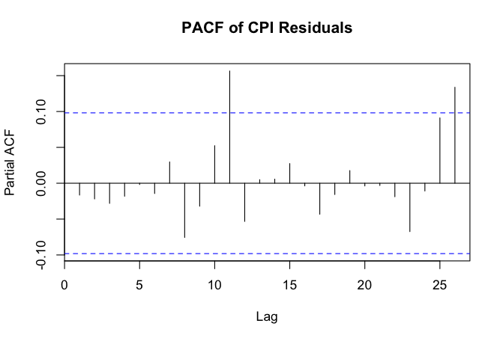
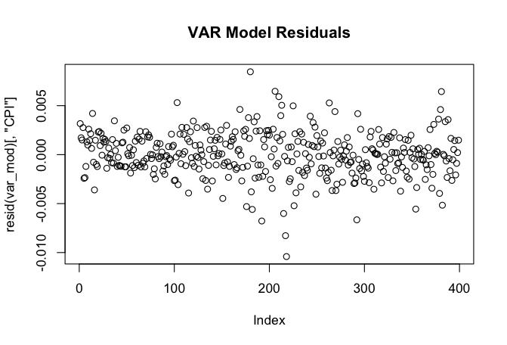
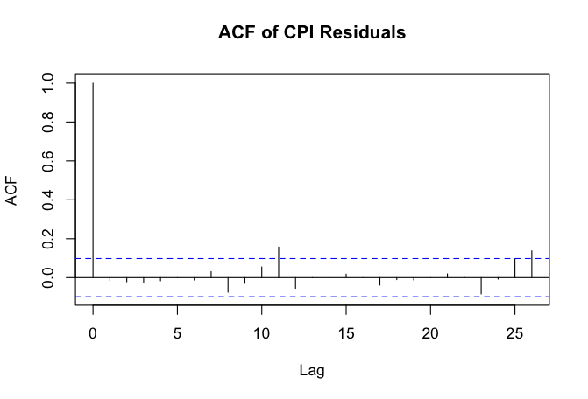
Detailed Model Results (Full Model)

Slide 39


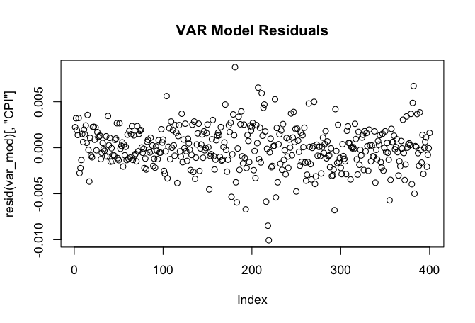


Detailed Model Results (Fed Fund + PPI)

Slide 40


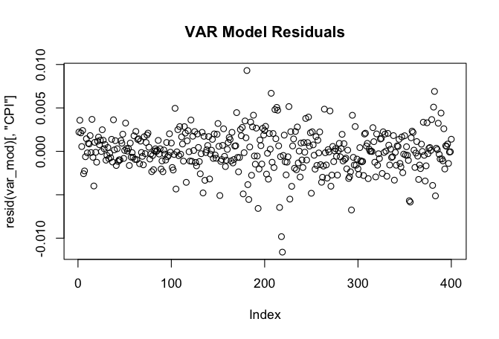
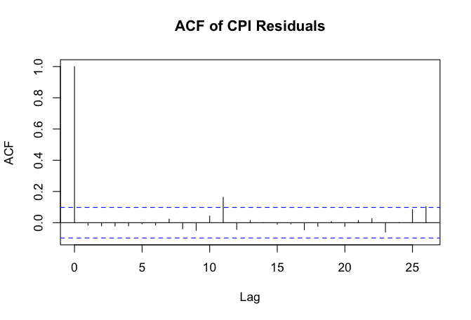
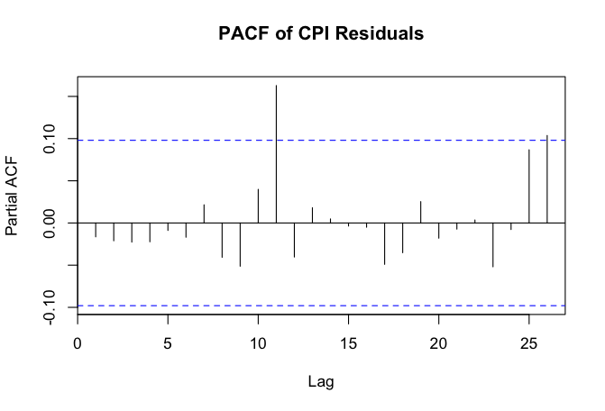
Detailed Model Results (PPI)

Slide 41


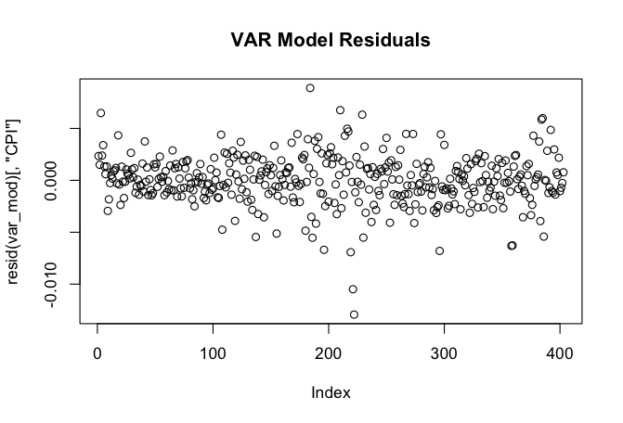
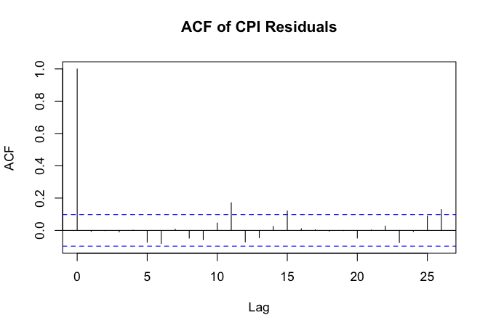
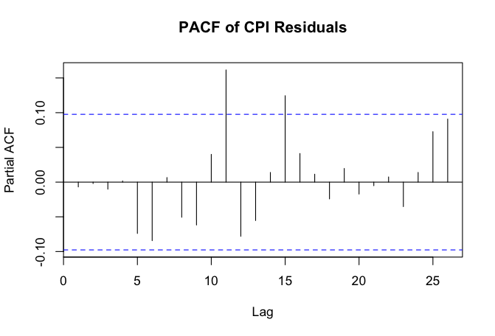
Detailed Model Results (Housing)

Slide 42


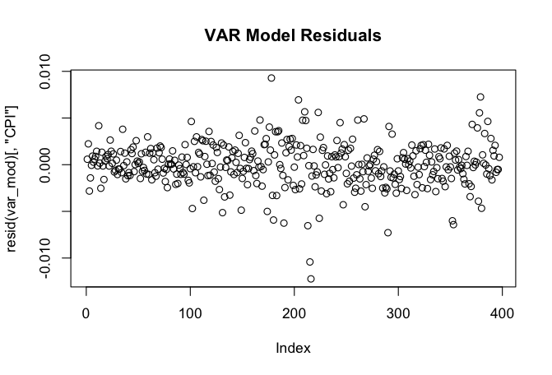
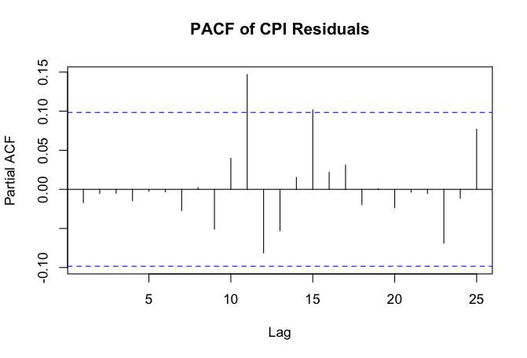
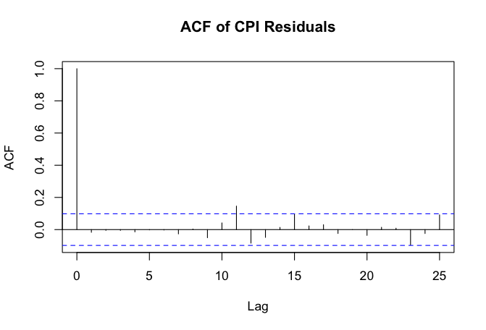
Detailed Model Results (Unemployment)

Slide 43


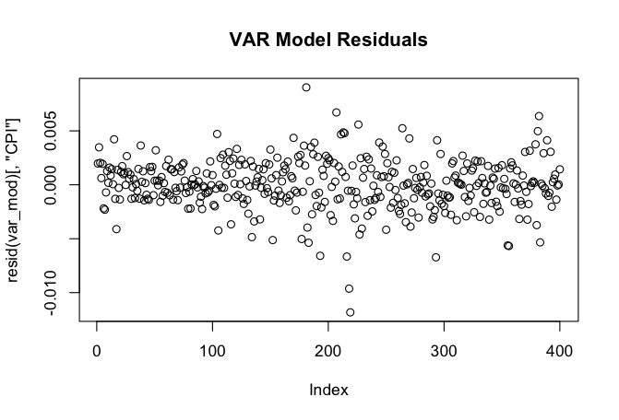
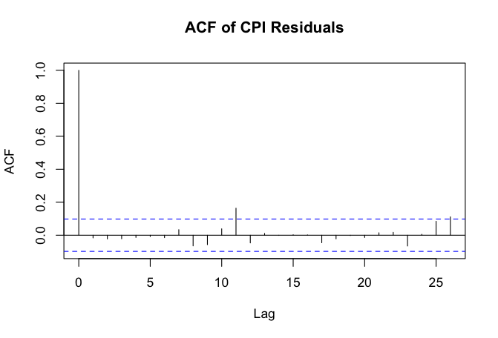
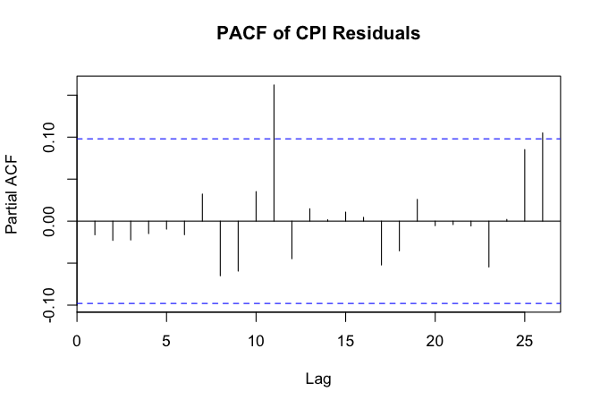
Detailed Model Results (PPI + Housing)

Slide 44





Detailed Model Results (Fed Fund)

Slide 45
Full Diagnostics (All Models)
 | Model | Lag | AIC | BIC | R_SQ | Adj_R_SQ | LogLik | LB_p | RMSE_CPI | MAE_CPI
3 | CPI+PPI+FedFund+Housing | 6 | -18123.156 | -17532.420 | 0.5576416 | 0.5137714 | 9209.578 | 0E+00 | 1.2426 | 1.1533
14 | CPI+PPI+Housing | 6 | -17698.945 | -17327.738 | 0.5394134 | 0.5019673 | 8942.472 | 0E+00 | 1.6095 | 1.5286
1 | CPI+PPI+Housing+Unemp+FedFund | 7 | -17368.286 | -16410.935 | 0.5580919 | 0.4989191 | 8924.143 | 3.789216E-10 | 1.2243 | 1.1426
2 | CPI+PPI+FedFund | 6 | -10961.833 | -10590.626 | 0.5528590 | 0.5165061 | 5573.916 | 3.108624E-14 | 1.1884 | 1.0976
12 | CPI+Housing | 3 | -10888.868 | -10736.908 | 0.5121700 | 0.4893030 | 5482.434 | 1.632028E-13 | 1.1547 | 1.0444
11 | CPI+PPI | 6 | -10533.736 | -10334.163 | 0.5344014 | 0.5046031 | 5316.868 | 0E+00 | 1.5709 | 1.4897
15 | CPI+FedFund | 3 | -4130.773 | -3978.814 | 0.5190777 | 0.4965345 | 2103.387 | 5.965578E-01 | 1.2193 | 1.1150
13 | CPI+Unemp | 9 | -2920.547 | -2673.542 | 0.5222625 | 0.4831037 | 1522.273 | 8.67111E-01 | 1.3823 | 1.3000

Slide 46


VAR Model Cross Validation (CPI + Fed Funds)
Baseline (No Intervention)
Step Intervention

Slide 47


VAR Model Cross Validation (CPI + Fed Funds)
Baseline (No Intervention)
Step Intervention

Slide 48

VAR Model Cross Validation (Champion Model)
Baseline (No Intervention)
Step Intervention

Slide 49


VAR Model Cross Validation (Champion Model)
Baseline (No Intervention)
Step Intervention

Slide 50

International Monetary Fund CPI Projections
IMF Projections for End of Year CPI index: 316.81
Our Projections for End of Year CPI Index: 314.06
Actual End of Year CPI Index: 315.61

Slide 51


Models – Dynamic Harmonic Regression
Step functions considered for intervention period during and post pandemic
Ramp function
Step function

Slide 52


Models – Dynamic Harmonic Regression
Full specification process for dynamic harmonic regression including steps for stationarity
CPI with non-seasonal d=1
Periodogram
ADF p-value = 0.01 KPSS p-value = 0.1
Raw periodogram
Top frequencies
Frequency | Spectral Density | Period
0.08266667 | 23.797697 | 12.096774
0.08533333 | 13.015241 | 11.718750
0.16533333 | 9.813474 | 6.048387
0.16800000 | 9.089882 | 5.952381

Slide 53

Models – Dynamic Harmonic Regression
Seasonal components from Fourier decomposition with K=4 and associated sine and cosine pairs

Slide 54
Models – Dynamic Harmonic Regression
AICc results for incremental model specifications
Step Function Specification
Fourier Freq. Specification
Exogenous Var. Specification
Intervention | ARIMA Error | AICc
N/A (Baseline) | ARIMA(0,2,3)(0,0,2)[12] | 783.2
Ramp | ARIMA(2,2,0)(0,0,2)[12] | 857.2
Ramp (Two Periods) | ARIMA(2,2,0)(0,0,2)[12] | 857.45
Step | ARIMA(0,1,2)(0,0,2)[12] | 760.66
Step (Two Periods) | ARIMA(0,1,2)(0,0,2)[12] | 761.34
K order | ARIMA Error | AICc
K = 4 | ARIMA(1,1,2) | 732.53
K = 3 | ARIMA(1,1,2) | 730.54
K = 2 | ARIMA(1,1,2) | 750.2
Exogenous | ARIMA Error | AICc
Federal Funds | ARIMA(0,2,2)(0,0,2)[12] | 776.26
Unemployment Index | ARIMA(0,1,2)(0,0,2)[12] | 775.83
PPI | ARIMA(0,1,2)(0,0,2)[12] | 782.73
Housing Index | ARIMA(2,2,1)(0,0,1)[12] | 758.45
All except PPI | ARIMA(0,1,1)(0,0,2)[12] | 733.6

Slide 55


Models – Dynamic Harmonic Regression
Forecast of best dynamic harmonic regression model
Regression components
Step intervention (one period)
Fourier frequency (K=3)
Federal Funds, Unemployment Index, Housing Index
With ARIMA(0,1,2) errors

